Slide 1
Chapter 4. Probability
http://mikeess-trip.blogspot.com/2011/06/gambling.html

Slide 2
Uses of Probability
Gambling
Business
Product preferences of consumers
Rate of returns on investments
Engineering
Defective parts
Physical Sciences
Locations of electrons in an atom
Computer Science
Flow of traffic or communications

Slide 3
4.1: Experiments, Sample Spaces, and Events - Goals
Be able to determine if an activity is an (random) experiment.
Be able to determine the outcomes and sample space for a specific experiment.
Be able to draw a tree diagram.
Be able to define and event and simple event.
Given a sample space, be able to determine the complement, union (or), intersection (and) of event(s).
Be able to determine if two events are disjoint.

Slide 4
Experiment
A (random) experiment is an activity in which there are at least two possible outcomes and the result of the activity cannot be predicted with absolute certainty.
An outcome is the result of an experiment.
A trial is when you do the experiment one time.

Slide 5
Total Number of Outcomes
How many possible outcomes are there for 3 cars to go either straight or make a right turn at an intersection?
S
SSS
SS
S
R
SSR
S
SRS
S
S
R
SR
R
SRR
S
RSS
S
RS
R
R
RSR
R
S
RRS
R
RR
R
RRR

Slide 6
Asymmetric Tree Diagram
No more than 2 cars are allowed to make the right turn in a row.
S
SSS
SS
S
R
SSR
S
SRS
S
S
R
SR
R
SRR
S
RSS
S
RS
R
R
RSR
R
S
RRS
R
RR

Slide 7
Sample Space
The sample space associated with an experiment is a listing of all the possible outcomes.
It is indicated by a S or Ω.

Slide 8
Event
An event is any collection of outcomes from an experiment.
A simple event is an event consisting of exactly one outcome.
An event has occurred if the resulting outcome is contained in the event.
Events are indicated by capital Latin letters.
An empty event is indicated by {} or ∅

Slide 9
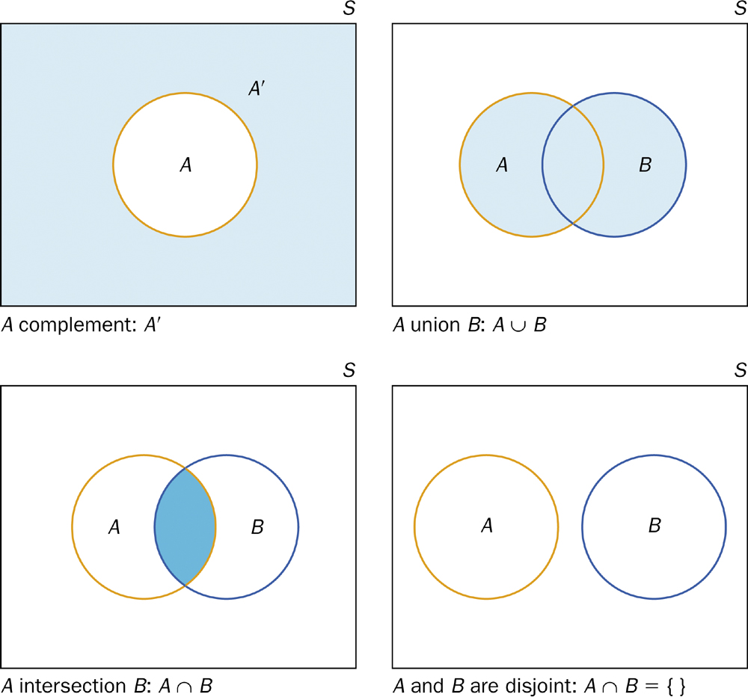
Set Theory Visualization

Slide 10
4.2: An Introduction to Probability - Goals
Be able to state what probability is in layman’s terms.
Be able to state and apply the properties and rules of probability.
Be able to determine what type of probability is given in a certain situation.
Be able to assign probabilities assuming an equally likelihood assumption.

Slide 11
Introduction to Probability
Given an experiment, some events are more likely to occur than others.
For an event A, assign a number that conveys the likelihood of occurrence. This is called the probability of A or P(A)
When an experiment is conducted, only one outcome can occur.

Slide 12
Probability
The probability of any outcome of a chance process is the proportion of times the outcome would occur in a very long series of repetitions.
This can be written as (frequentist interpretation)
$$P\left(A\right)≈\lim_{N→∞}{\frac{n}{N}}$$

Slide 13
Bayesian Statistics
Bayesian probability belongs to the category of evidential probabilities; to evaluate the probability of a hypothesis, the Bayesian probabilist specifies some prior probability, which is then updated in the light of new, relevant data (evidence). – Wikipedia
https://en.wikipedia.org/wiki/Bayesian_probability#Bayesian_methodology

Slide 14
Properties of Probability
1. For any event A, 0 ≤ P(A) ≤ 1.
2. If ω is an outcome in event A, then
$$P\left(A\right)=\sum_{i}{ω_{i}}$$
3. P(S) = 1.
4: P({}) = 0

Slide 15
Types of Probabilities
Subjective
Empirical
$$P\left(A\right)=\frac{number of times that A occurs}{total number of times}$$
Theoretical (equally likely)
$$P\left(A\right)=\frac{number of outcomes in A}{number ofoutcomes in S}$$

Slide 16
Probability Rules
Complement Rule
For any event A, P(A’) = 1 – P(A)
General addition rule
For any two events A and B,
P(A U B) = P(A) + P(B) – P(A ∩ B)
Additional rule – Disjoint
For any two disjoint events A and B,
P(A U B) = P(A) + P(B)

